Slide 1

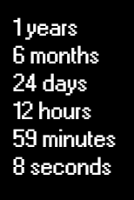





Working Experience
Languages

